Slide 1
Android application
Made in Java, using Android Studio

Slide 2
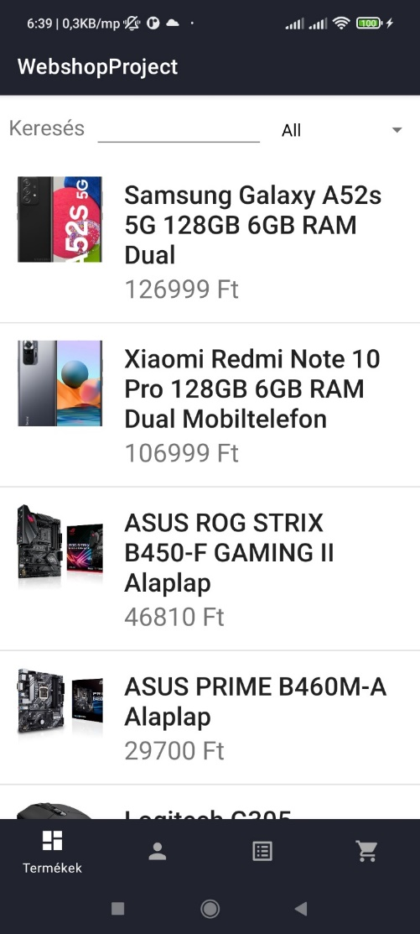
Advantages
The application allows the user to get a more transparent interface than if they had to view it on a web page.
An application can has much more potential in functionality, because it can use more tools like: fingerprint scanner for authentication, or QR code scanner.
Faster access: users don’t need to type the website’s address like in the browser.
We can send notifications to the user if a product is on sale or if there’s other news to tell.

Slide 3
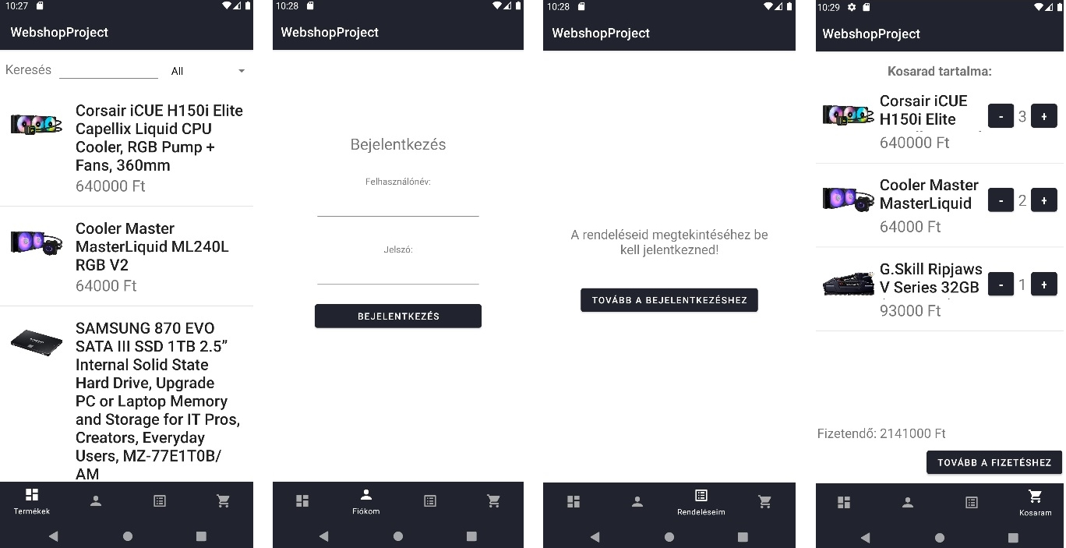
Menus

Slide 4
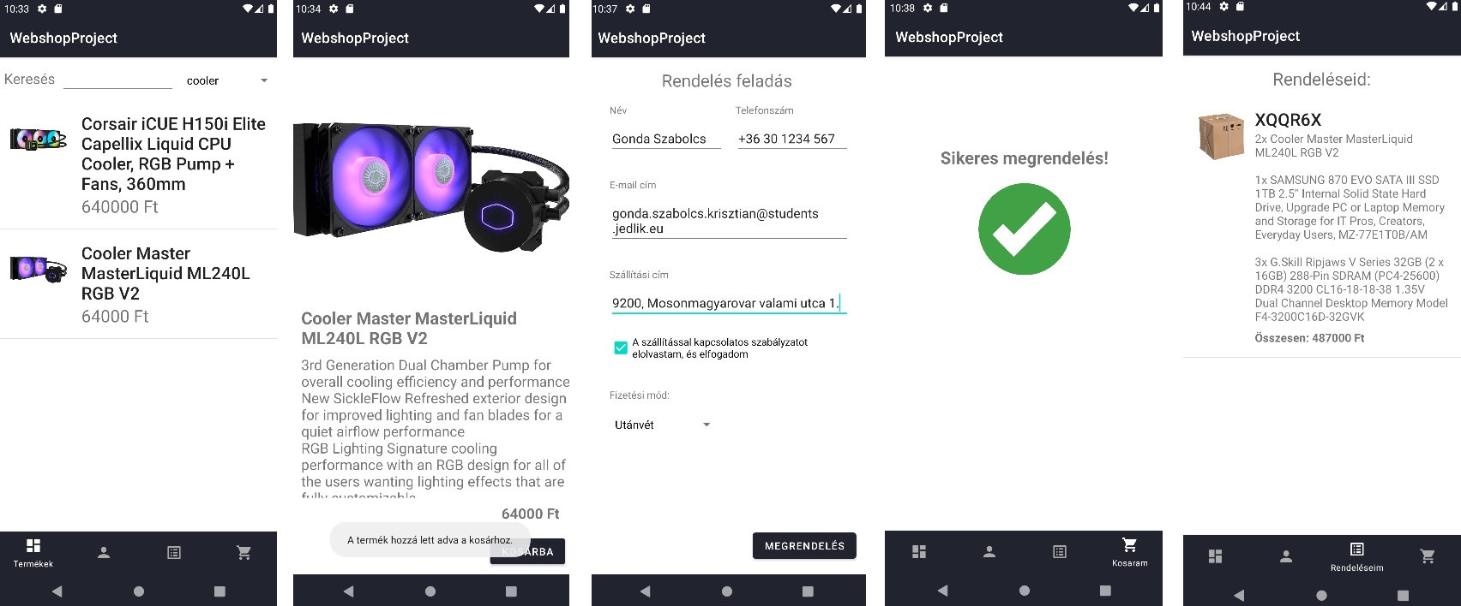
The order making process

Slide 5
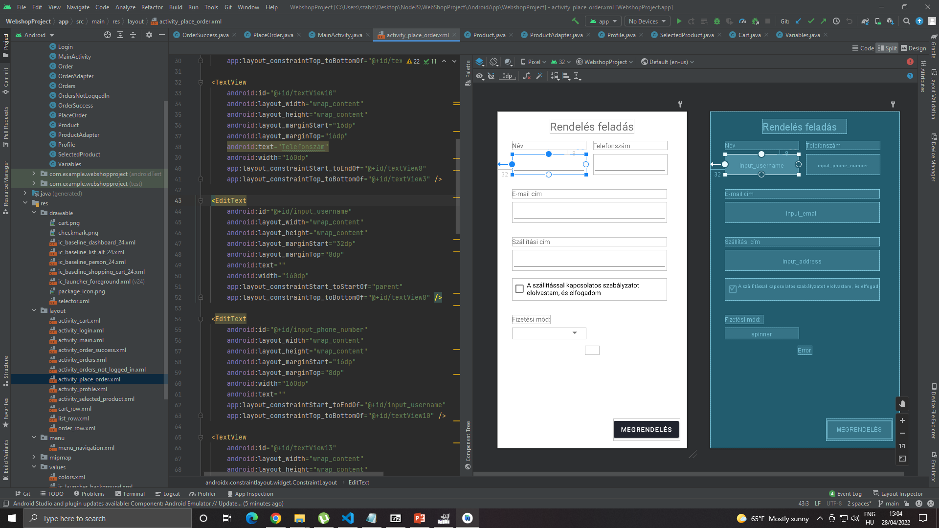

Slide 6
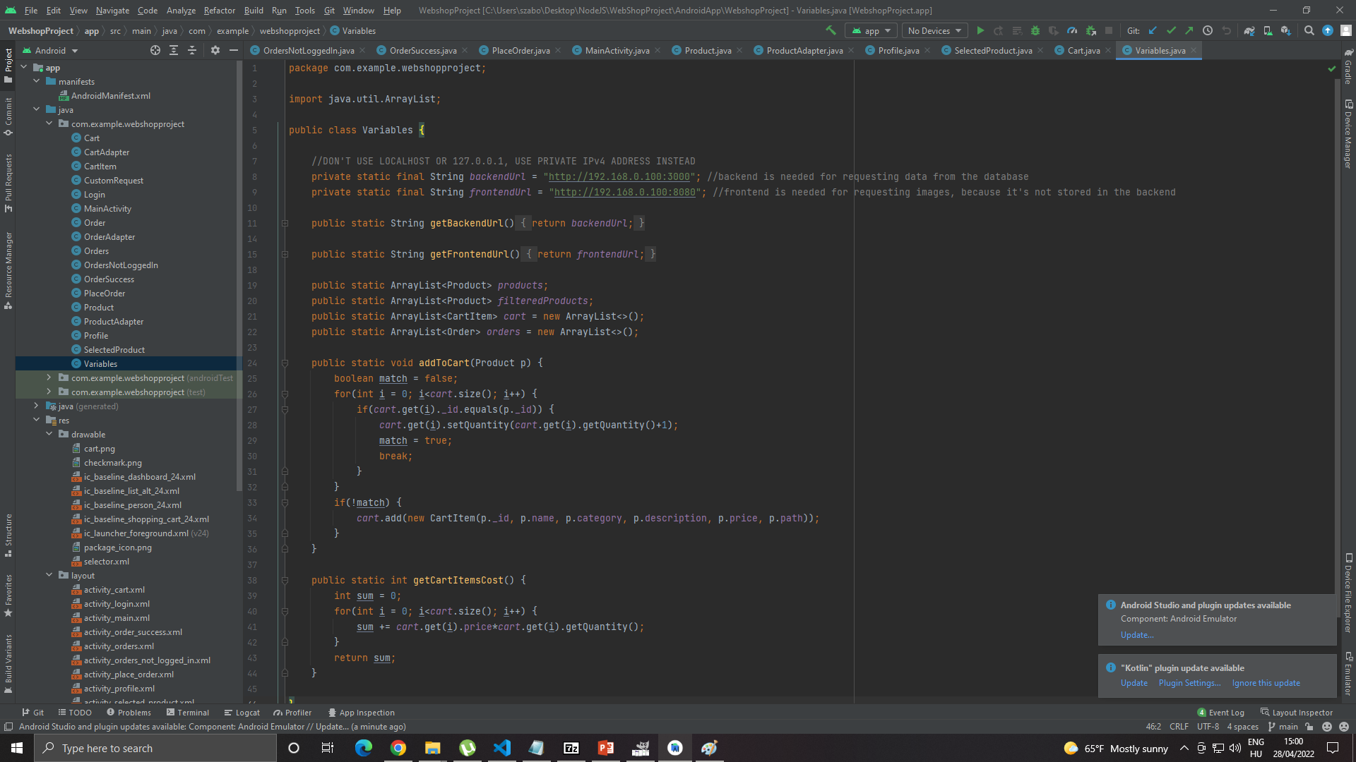

Slide 7
Thanks for your attention!
The Android application and the presentation was made by: Krisztián Szabolcs Gonda

